Slide 1
New Leaders Assimilation Program

Slide 2
Reducing Outbound %
Prepared by - Rahul Nethikar

Slide 3
Reducing Outbound % of the Verizon DSL Floor
Problem Statement & Goal Statement

Slide 4
What is Outbound ?
Any call made by the Agent to the Customer from the Contact Centre is called an Outbound Call
Outbound calls are an integral part of Technical Support Contact Centre as it helps in enhancing the customer experience
How is Outbound% Calculated ?
Outbound % = Time spent on Aux9/ (Staffed time-(Aux1+Aux2))*100

Slide 5
Impact of High Outbound on Business
Impacts Revenue
Impacts Service Level
Disturbs Forecasting
Calls handled per associate decreases

Slide 6
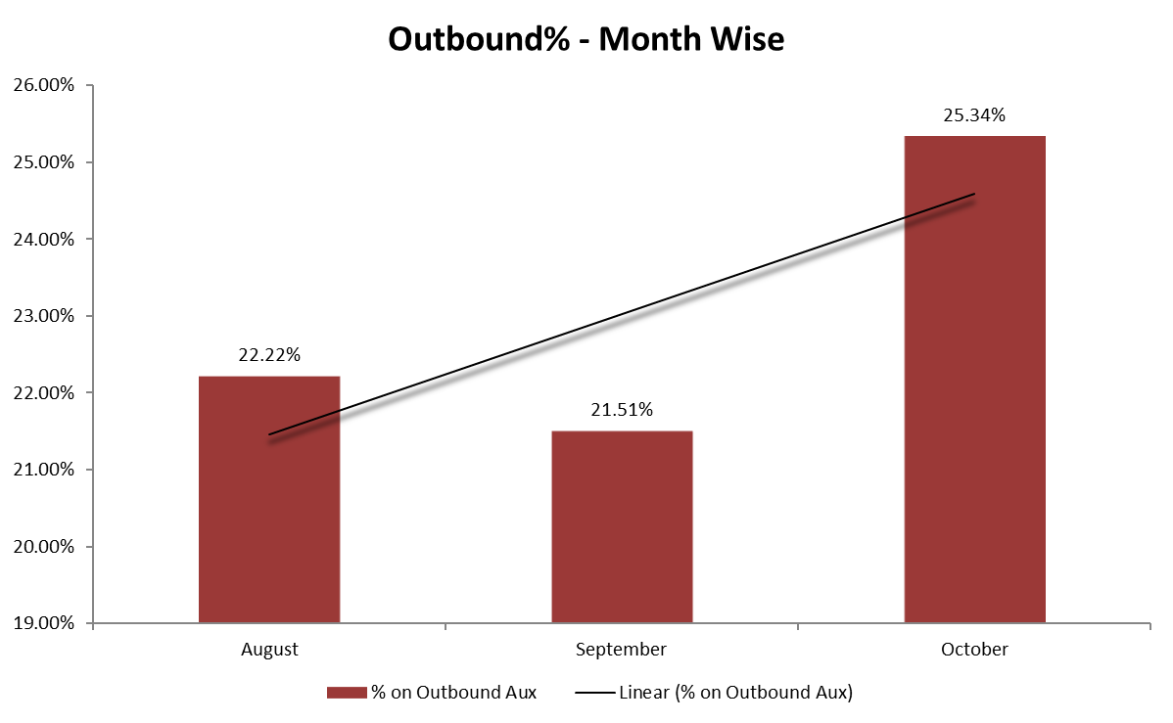

Outbound% Trend – Month Wise

Slide 7
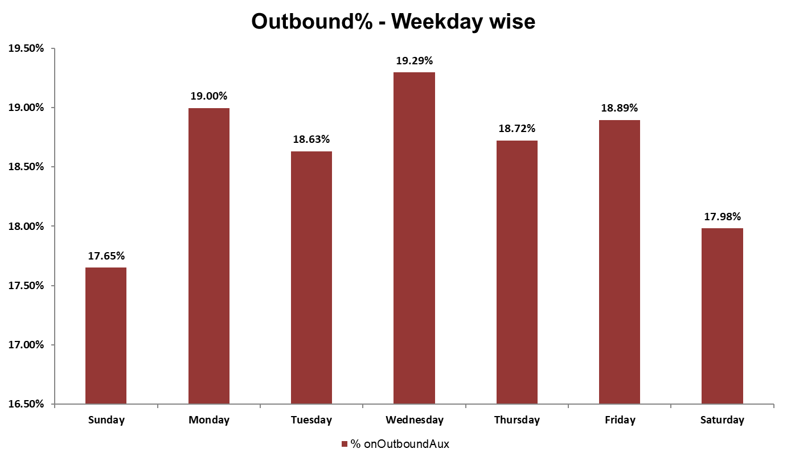
Outbound%Trend – Day Wise

Slide 8
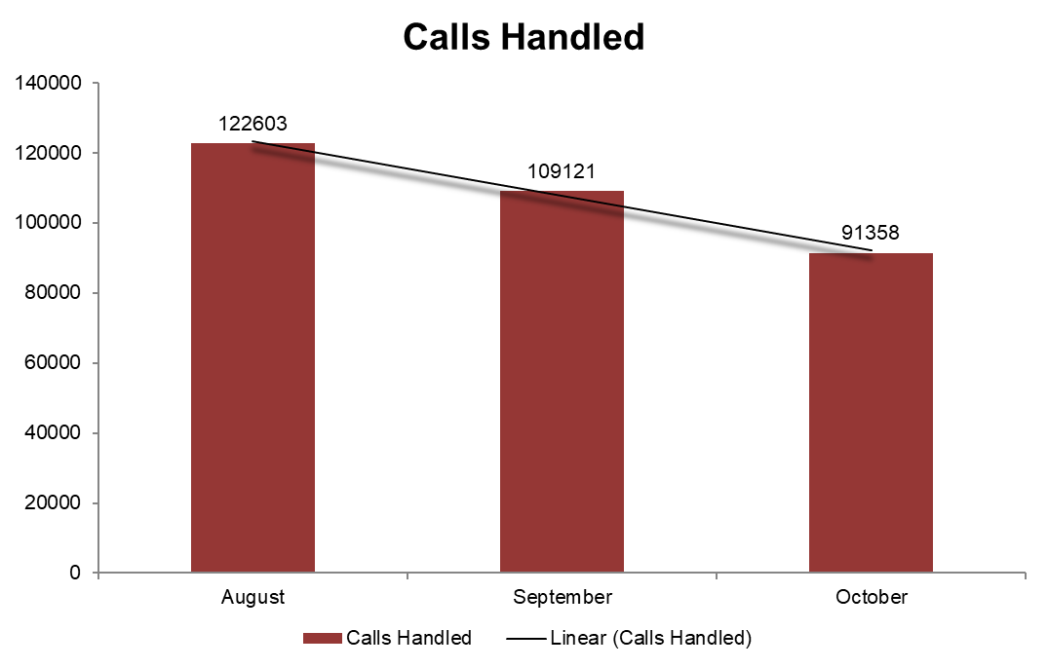
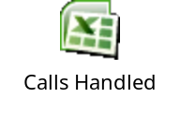
Impact of Outbound on Calls Handled

Slide 9







FishBone analysis
Root Cause Identified
People
Process
Documenting on OCT
Challenge in reaching LBO
Limited information on the tool
Long wait time to transfer calls to Internal department
(Billing & Dispatch)
OCT
follow ups
Avoiding Inbound at the end of the Shift
Proactive Call Back
Courtesy Call Backs
VISS Installation
Call back for scheduling a call back at later time
Calling 800 numbers
Power cycling the CPE
Customer requests for Call back
High
Outbound %
Unable to interpret Network ticket updates
Incomplete Troubleshooting on inbound call
Outage/Verizon Issue
Static online
Unable to resolve Calls taken at end of Shift
Dropped Calls
Performance
Technology

Slide 10
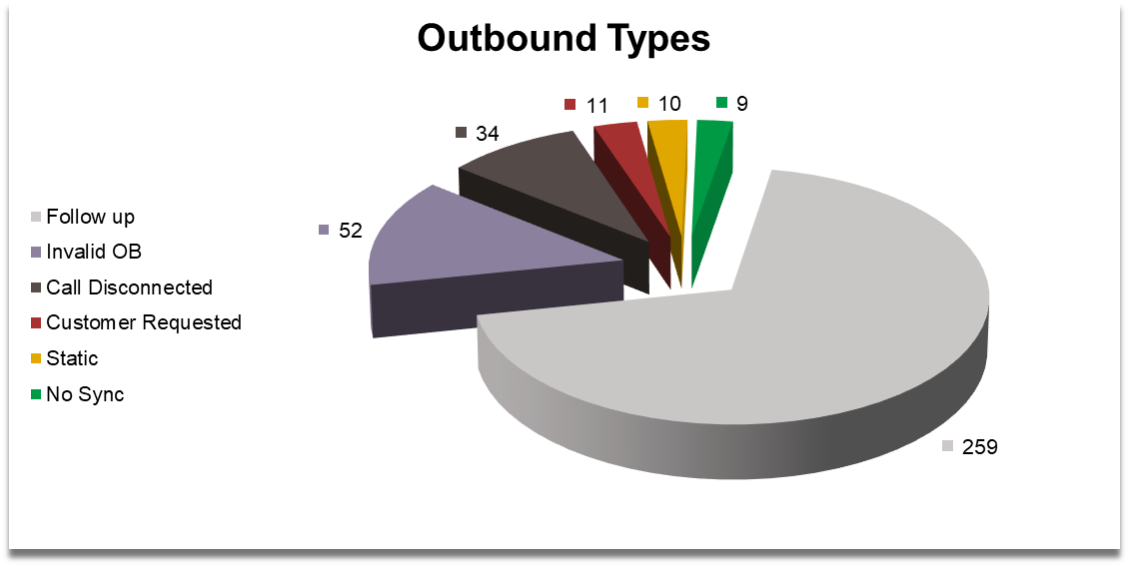
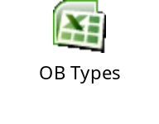
Outbound Types
Disconnected Calls
Customer Requested Calls
Follow up Calls
No Sync Calls
Static on Call
Invalid Outbound Calls

Slide 11
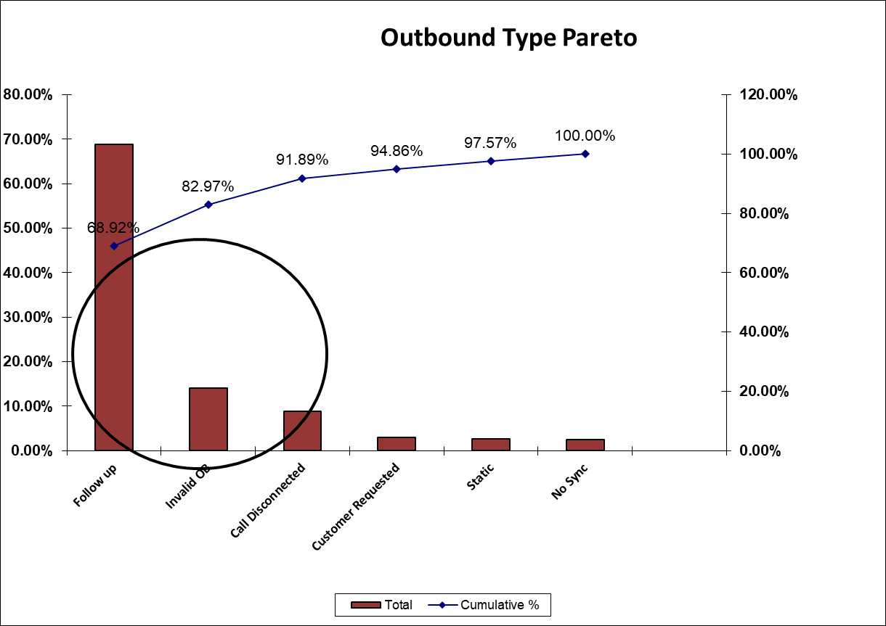

Pareto Analysis

Slide 12
Follow up Outbound Types (various surveyable Resolution Action types)
Improvement Actions
Front Line Resolved
Configured Modem/Router
Configure Wireless
Configure 3rd Party
NA/Blanks
PC Software
Powercycle Modem
Disable Wallgarden
Configured Client
Client configuration
Client configuration
Area Network outage
Reset password
Power reset modem
DSL phone cable
Modem Replacement
PC cabling
Filter
Reset IP
Inside wiring

Slide 13
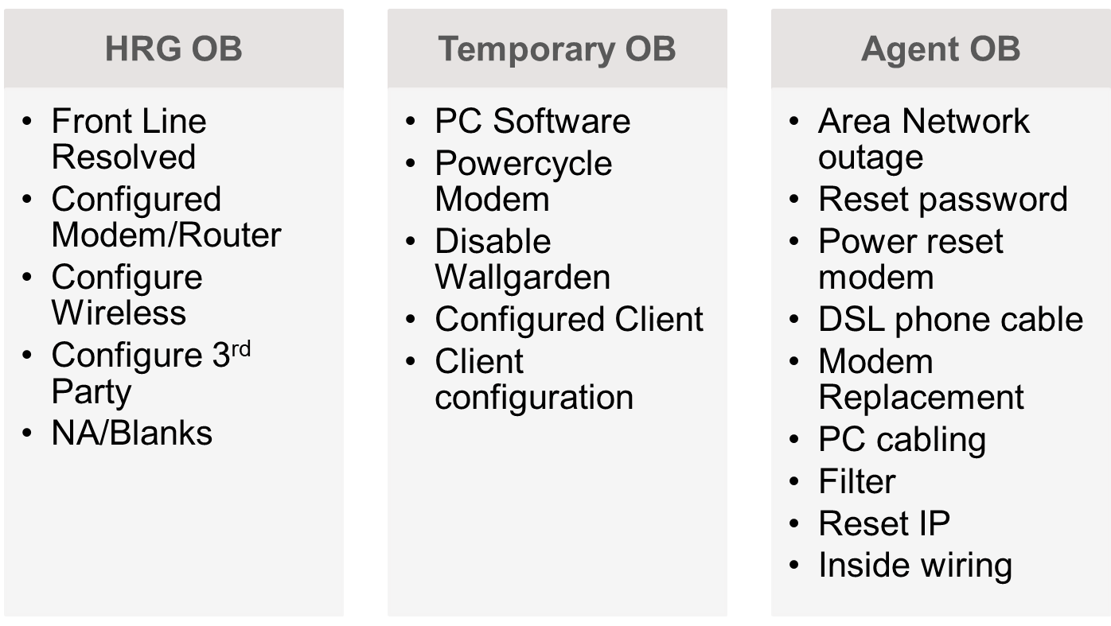
Outbound alignment
Divided according to the various surveyable Resolution Action types

Slide 14

Outbound Impact matrix
Control Impact Matrix | High Impact | Low Impact
High Control | Unable to resolve Calls taken at end of Shift Warm transferring instead of cold transferring Agent not aware of Tool usage(<90Days) | Network Outages VISS Installation
Low Control | Long wait time to transfer calls to Internal department (Billing & Dispatch) Making an Outbound Calls at the end of shift (Staffed Hours) NPS Call backs Static On call Customer requests for Call back | Agent asks the customer to unplug CPE

Slide 15
Type of Invalid Outbound Calls
Agent calling Toll Free Numbers
Outbounds done at the end of shift
Proactive Call Backs to reduce AHT
Call Release
No Sync Calls

Slide 16
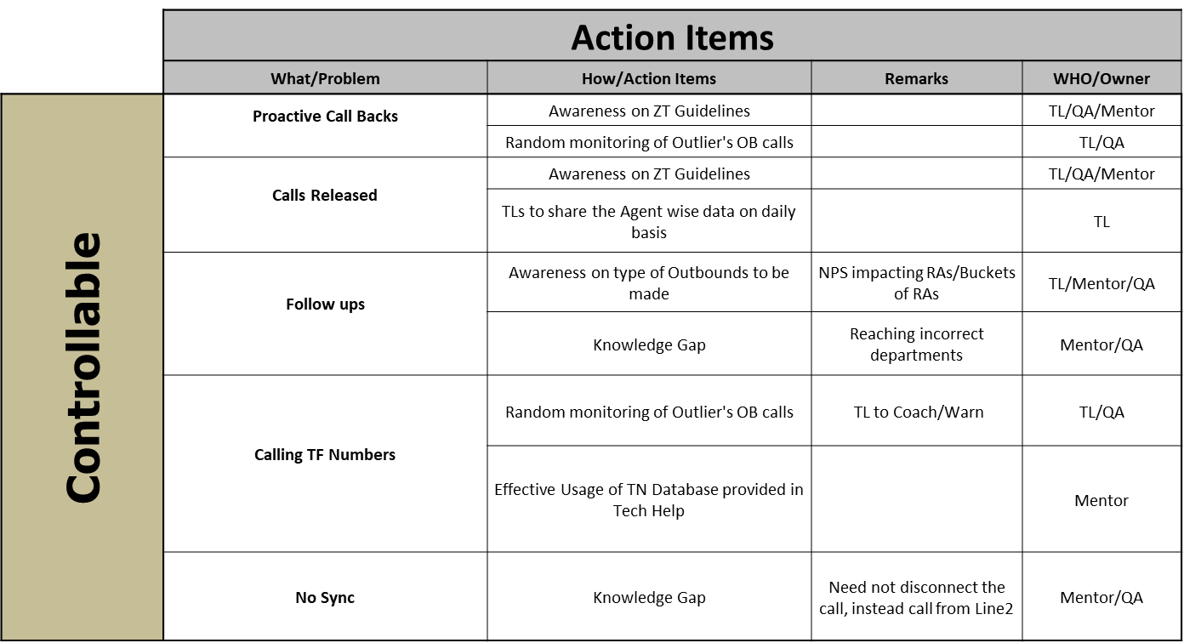

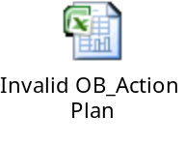
Action Plan for Invalid Outbounds

Slide 17
Static on call
Phase out the old Head sets and replace them with the latest ones

Slide 18
Effective Follow ups by Relegiously following the various follow up buckets
Project Outcome
Reduced Invalid Outbound Calls
New Head Sets to address the Static on call Issues
Ultimately Reducing the Outbound % and Increasing the Inbound traffic for more Revenue and Prosperity

Slide 19
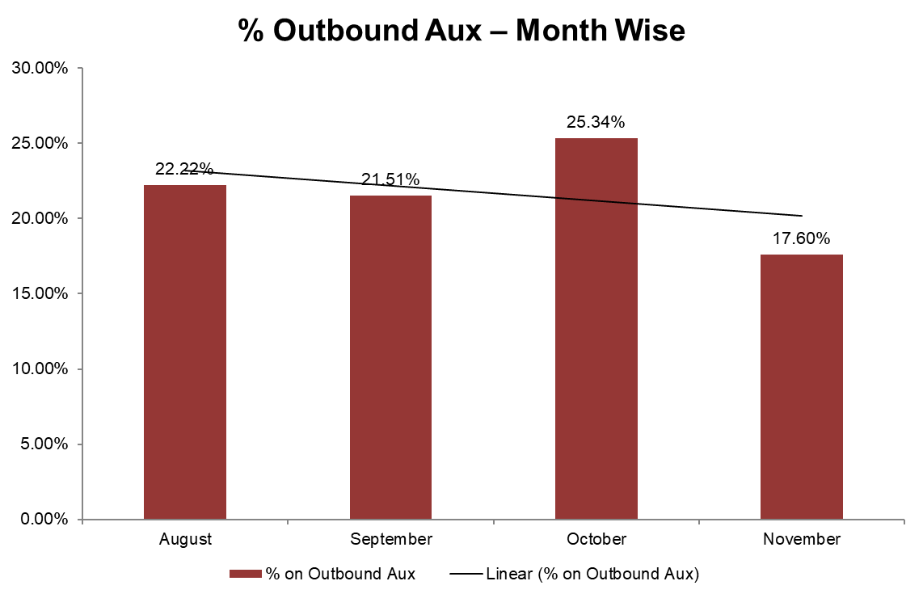
Outbound Trend Post implementation of the Project
Project Outcome

Slide 20
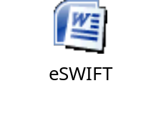


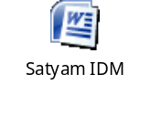
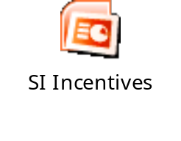
Activity Check-list Implementation
Name of the activity | Learning acquired | Supporting Documentation | Outcome of Implementation
Presentation on Orientation of Satyam BPO. Making a presentation on the same to your team members | Usage of eSWIFT portal |  | Spreading awareness of usage of eSWIFT portal as it is accessible for every associate of SatyamBPO
Extreme Collaboration – with three associates from the support functions. | HR – Rishabh CS – Praveen A Satyam IDM – Neelima K |  | Learned more about the various Support Functions and their areas of interest/Functionality with Hierarchy
Identification of one area of concern in your current process and recommending a plan of action for the same | Associates from the DSL floor were not inclined to apply to join an escalations team with the same Title and same Incentives |  | SI Associates have started to attract more associates from the DSL floor to the SI Team by doing Mouth Publicity of the Incentives
Conducting a Team Building activity in your process | Making use of the Tools Downtime in a Productive way | Process Quiz with the Associates including the participation of SME, Team Lead and Ops Manager | Team Jelling and Enhanced Fun while at work without impacting the Business

Slide 21
Safe Harbor
© Satyam BPO 2008
Certain information contained in this presentation, including within statements/press releases /announcements / documents added hereon, may be "forward-looking statements" within the meaning of the Private Securities Litigation Reform Act of 1995. Such forward looking statements/press releases/announcements/documents involve a number of risks, uncertainties and other factors that could cause actual results to differ materially from those that may be projected by these forward looking statements.
Satyam BPO Limited (“Satyam BPO”) cautions readers that actual results could differ materially from any forward-looking statements which may be deemed to have been made in this presentation or which are otherwise made by or on behalf of Satyam BPO. Factors which may affect results include, but are not limited to, new and rapidly changing developments relating to information technology and related technology and products, new technology developments, developments and regulation in the information technology and related industries, the risk of loss of management and personnel, the competitive environment within the information technology and related industries, the ability of Satyam BPO to develop its infrastructure, the ability of Satyam BPO to raise additional capital to continue to develop and sustain business at current levels and to implement Satyam BPO's business plan, the competence required and experience of management and economic conditions.
For this purpose, any statements contained in this presentation or which are otherwise made by or on behalf of Satyam BPO that are not statements of historical fact may be deemed to be forward-looking statements. Readers are cautioned not to place undue reliance on any forward-looking statements.
Satyam BPO undertakes no obligation to update any forward-looking statements to reflect new information, events or circumstances or to reflect the occurrence of unanticipated or updated events and expressly disclaims any and all liability that may accrue to Satyam BPO as a result of readers placing any reliance on such forward-looking statements.

Slide 22
Thank You

